Slide 1
Data Insights on Olist Store in Brazilian Ecommerce Platform
Portfolio Project 1
Cohort 12
Group E

Slide 2
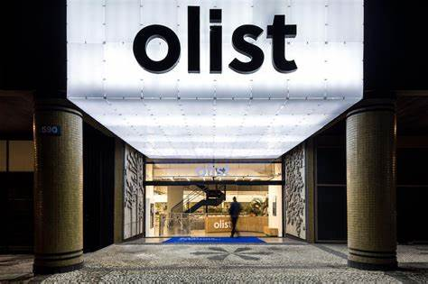
Introduction
Olist is thriving over the recent years by building international partnerships as well as supporting local small businesses by providing strong network.
The dataset analyzed in this presentation has information of over 100,000 orders generated across different cities of Brazil during period of 2016 to 2018.
Olist store has sellers offering over 70 categories of products, ordered using multiple modes of payment.

Slide 3
Overview of Dataset
The Olist Store has provided data covering
product categories
city wise information of its customers and sellers
delivery days details
mode of payments
customer ratings
order details for sales over the period of 2 years
Objective of this project is to analyze provided dataset and develop insights that can assist company management to expand its business and develop new strategies.

Slide 4
Objective
To have a clear picture of how and which factors affect the sales of Olist store, we look into following four dimensions
How many product categories and products does the store offer? Which are the most selling product categories and generate high sales revenues?
What is the pattern in sales generated across different states in Brazil? How do customer demographics affect the sales?
Which payment methods are used while purchasing from the Olist platform? And how does it impact sales?
What are the seasonal trends in sales? In which season do customer are more inclined towards purchasing and what are their product preferences?

Slide 5
Sales Analysis
We determine the product categories which have the highest sales, and further find its customer concentration along with its sales value.
Average customer review ratings particularly for high selling product categories is visualized.
Trend in quarter over quarter growth for the two years reflects magnified growth in product portfolio as well as sales revenue
As Brazil has 27 states having diversified culture and population, number of sales in different states gives geographical overview of Olist customer base.

Slide 6
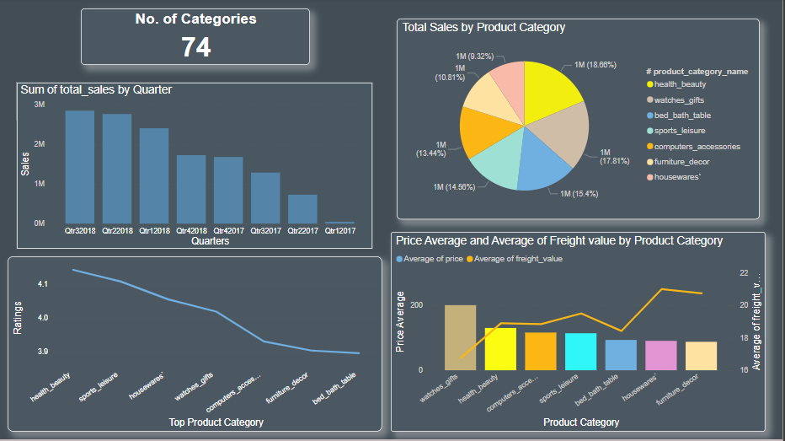
Analysis by Product Category

Slide 7
Insights
Health & beauty products have brought in the highest revenue of 12.5 MN BRL, whereas watches and gifts have relatively fewer orders but have bought a high revenue of almost 1.2 MN BRL.
The maximum average review rate is 4.3, which means there are areas where customers' expectations are not met. The underlying reason may be delayed delivery time or high freight charges for low- priced products

Slide 8
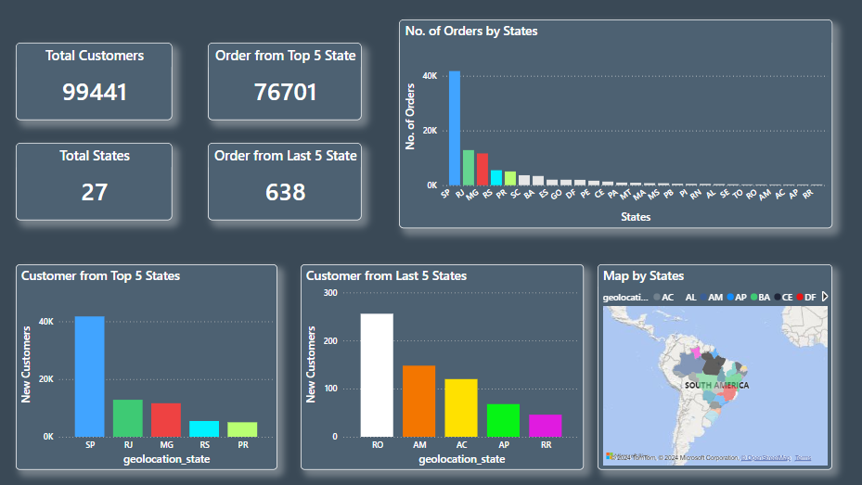
Regional Disparity Analysis

Slide 9
Insights
Regions with high sales (SP, RJ and MG) performance are likely benefiting from effective marketing strategies, robust distribution networks, or higher regional demand.
Regions with low sales performance may suffer from lack of awareness, poor distribution channels, or unfavorable economic conditions.

Slide 10
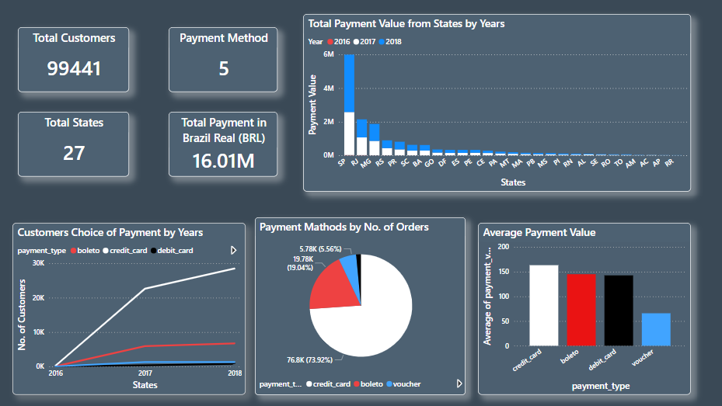
Payment Method Analysis

Slide 11
Insights
Different regions may have distinct preferences for payment methods but Credit cards have used in majority.
Observing changes in payment method preferences over the years like Credit Card have grown 3 to 4 times and as Boleto payments have also increased.

Slide 12
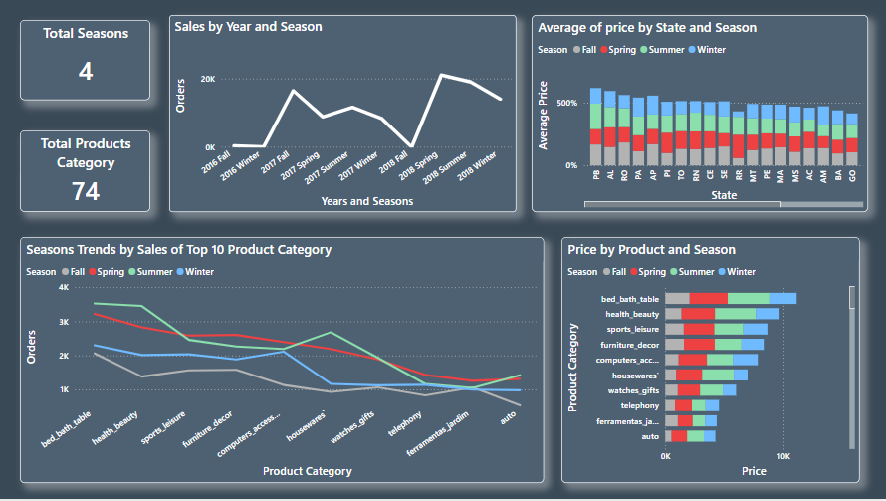
Analysis by Seasons

Slide 13
Insights
Sales may spike during specific seasons due to regional cultural or climatic influences like we have seen growth in spring and summer seasons.
Average prices of products may vary by season, Summer and Spring usually have more product prices.

Slide 14
Recommendations
Increasing trend in sales indicates opportunities for further growth, hence Olist should strengthen its network across the country and adopt strategies to reach more number of customers.
Olist should focus on partnering with sellers who provide competitive products in the high selling categories of bed & bath, health & beauty, sports leisure, and furniture decoration.
For High Sales Regions, Explore opportunities for introducing new products or services in these regions.
For Low Sales Regions, Implement targeted marketing campaigns to raise awareness and stimulate demand.

Slide 15
Recommendations
Consider partnerships with local businesses or influencers to increase market presence
Ensure the availability of popular payment methods in each region.
Continuously monitor shifts in payment preferences to stay ahead of consumer behavior changes.
Adjust inventory levels based on seasonal demand patterns to avoid stock outs or overstock situations.
Launch marketing campaigns and promotions around high-demand seasons to maximize sales.

Slide 16
Conclusion
In analysis we observed that the total revenue exhibits considerable growth over time. Secondly, São Paulo stands out as the top city in terms of customer distribution.
Olist can tap on larger customer base by working on delivery days, logistic and better partnerships based on customer demographics.
This analysis will help the company to identify the right partners, cities to penetrate in and improvise customer experience of shopping from their store.

Slide 17
Data Source
Brazilian E-Commerce Public Dataset from 2016 to 2018 by Olist from Kaggle.
Group E
Nazish Abdullah
Muhammad Jawad Hassan
Eyman Ameer

